Slide 1
Capstone Project
Project Title
NETFLIX MOVIES & TV SHOWS CLUSTERING
By
Puneet Subhanji

Slide 2
CONTENT
Introduction
Abstract
Problem Statement
Handling Null Values and feature engineering
EDA
Hypothesis Testing
Finding Number of Clusters
Algorithm
Model Performance
Interactive scatterplot of the cluster
Conclusion

Slide 3
Introduction
Netflix is a well-known OTT platform that offers a diverse range of material from various countries and genres, so keep an eye on it.
The goal is to forecast clusters based on comparable content by analyzing text-based features, in this example, the description column, which is a brief graphic summary of the contents.

Slide 4
ABSTRACT
The objective was to use text-based criteria to anticipate clusters of related information.
To draw insights from the dataset, exploratory data analysis is performed, but the first null findings are ignored.
In addition, using EDA's findings, some hypothesis testing was done.
After that, our target variable, the description column, must be feature engineered, with NLP operations such as symbol removal, stop words, punctuation, tokenization, and vectorization using TFIDF done on it.
All that remained was to locate the clusters, based on the number of clusters, we fit our models and using assessment metrics, evaluate the model.

Slide 5
PROBLEM STATEMENT
This dataset contains TV shows and movies that are currently accessible on Netflix as of 2019. The data was gathered through Flixable, a third-party Netflix search engine.
In 2018, they presented an exciting research revealing that the number of TV shows available on Netflix has nearly tripled since 2010. Since 2010, the number of movies on the streaming service has dropped by almost 2,000 titles, while the number of TV episodes has nearly tripled. It will be fascinating to see what additional insights can be extracted from the same dataset.
Combining this dataset with other external datasets like IMDB ratings, rotten tomatoes can also provide many interesting findings.

Slide 6
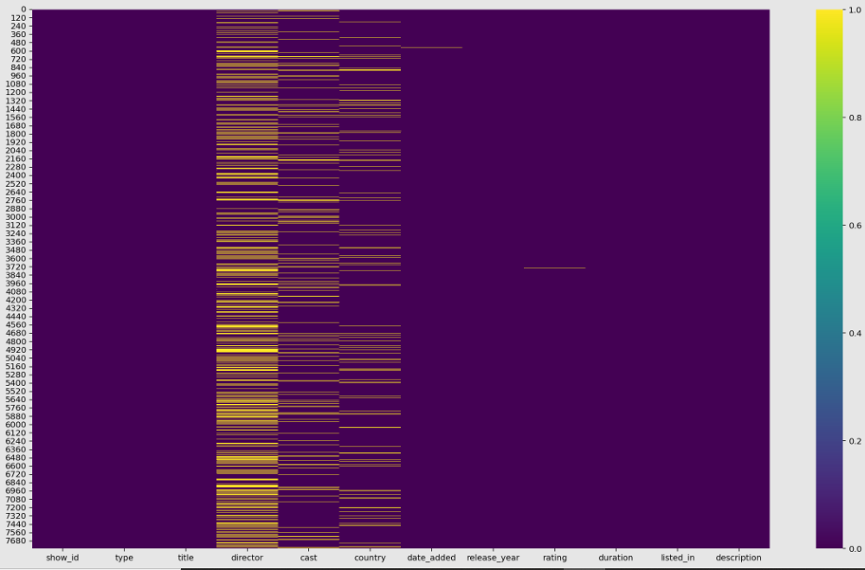
Handling Null Values and feature engineering
After loading the dataset, i checked for null values and eliminated them, as well as some irrelevant columns.

Slide 7
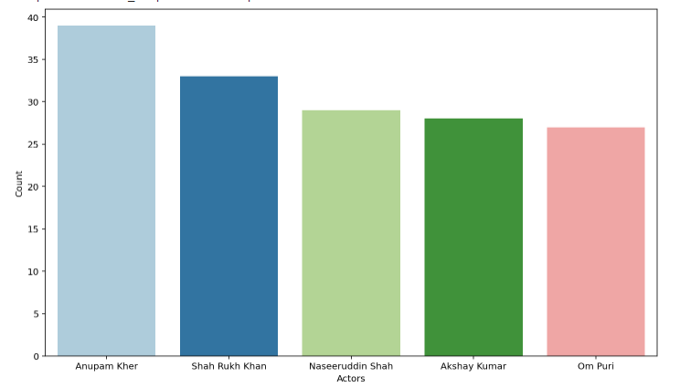
EDA
Name of the Actors who acted more times only for Indian Movies?
As we can see from the plot, Anupam Kher has acted in more Indian films than anyone else.

Slide 8
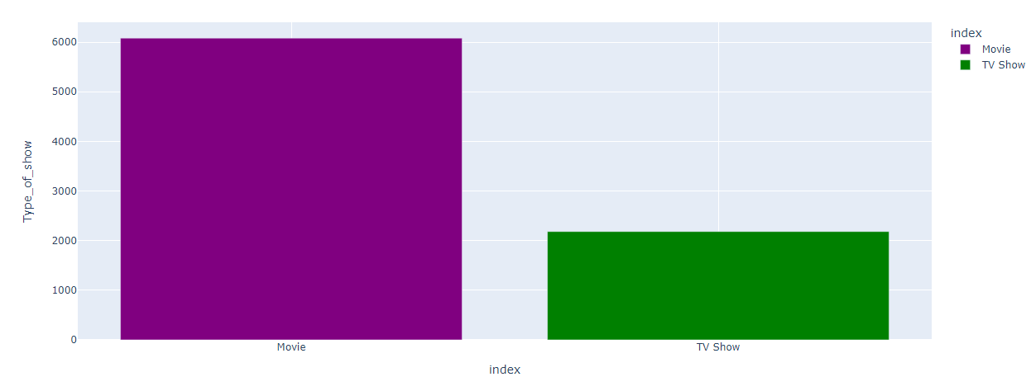
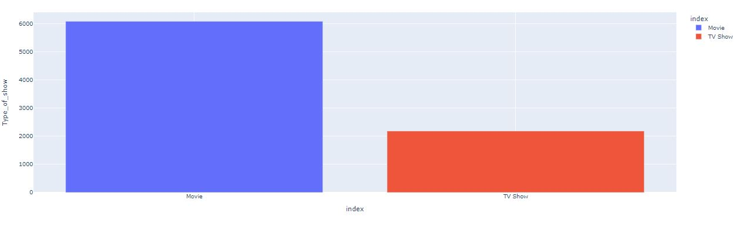
EDA cont.
What is more popular on Netflix, movies or TV shows?
As we can see in the plot, there are more movies available on Netflix compared to TV shows. That means movies are more popular than TV shows.

Slide 9
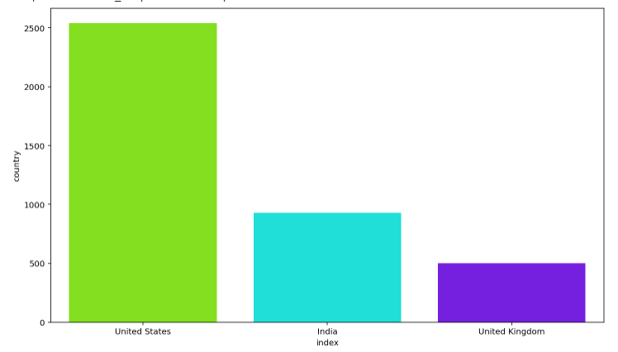
EDA cont.
Analysis of the top two countries where Netflix is most popular?
As can be seen in the plot above, the United States and India are the two countries where Netflix is most popular.

Slide 10
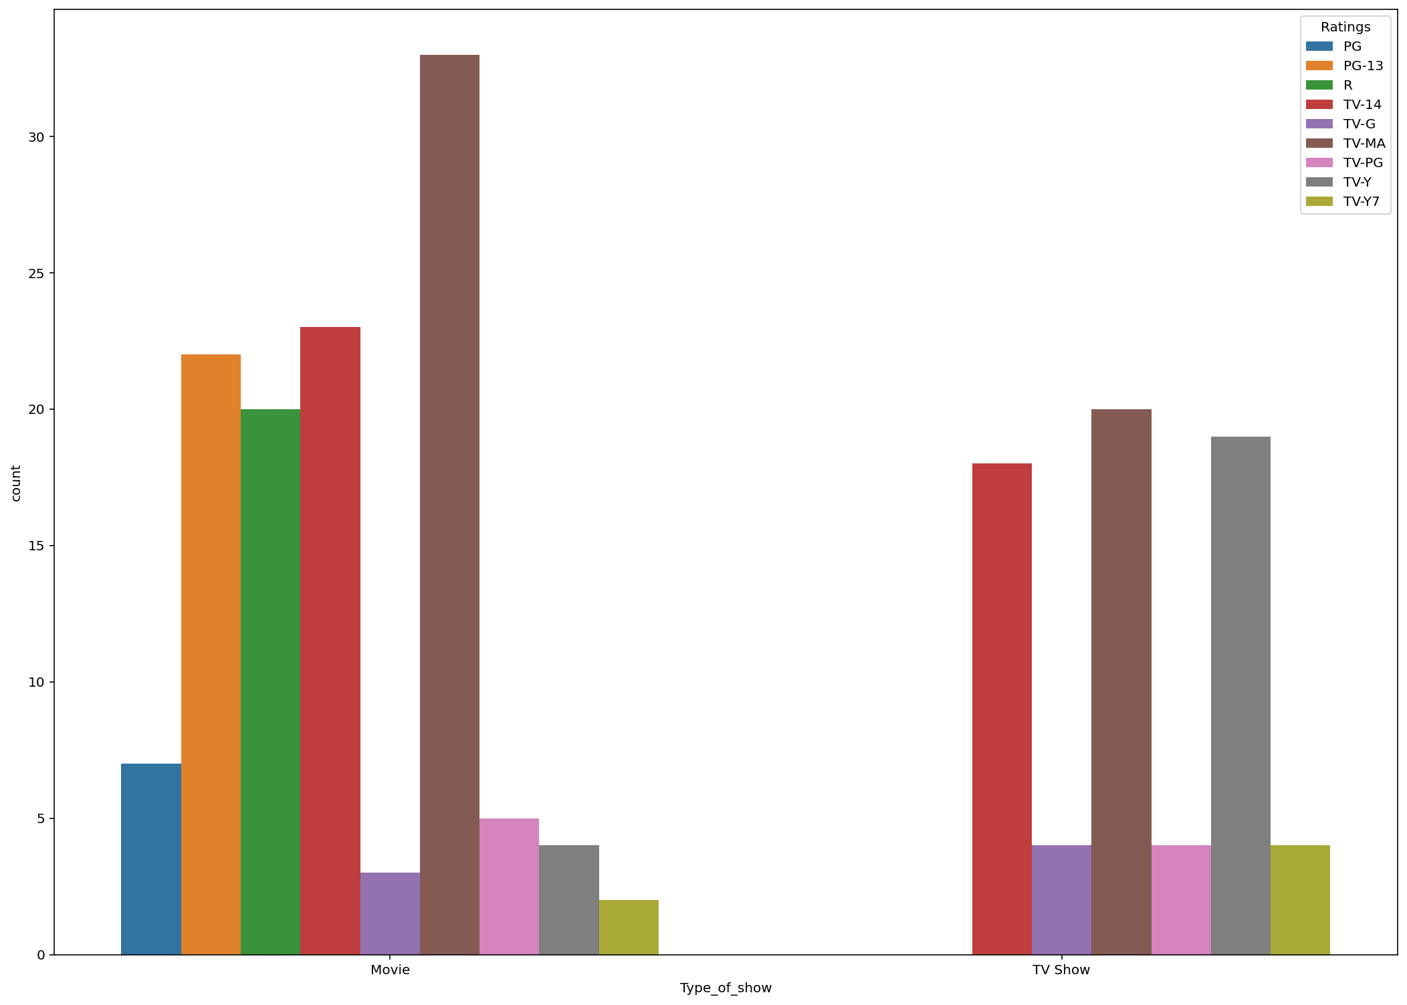
EDA cont.
Analysis of type of shows launched and highest rating of movie in December 2020?
As shown in the plot above, TV-MA ratings in December 2020 are the highest in movies and TV shows, with TV-MA standing for Mature Audience Only. Because this programme is intended for adults, it may not be appropriate for children under the age of 17.

Slide 11
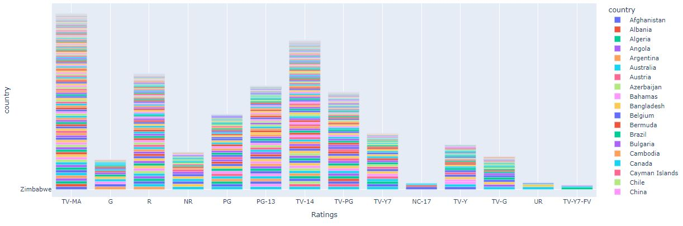
EDA cont.
Analysis of type of content available in different countries?
As we can see from the plot above, there are various types of content available, but in most countries, TV-MA content is available, and the TV-MA rating you see on many Netflix TV series signifies that the programme is only suitable for mature viewers. A TV show with a TV-MA rating features graphic violence or a combination of brutal violence. So that could be the reason for it, because the Netflix audience enjoys this type of content.

Slide 12
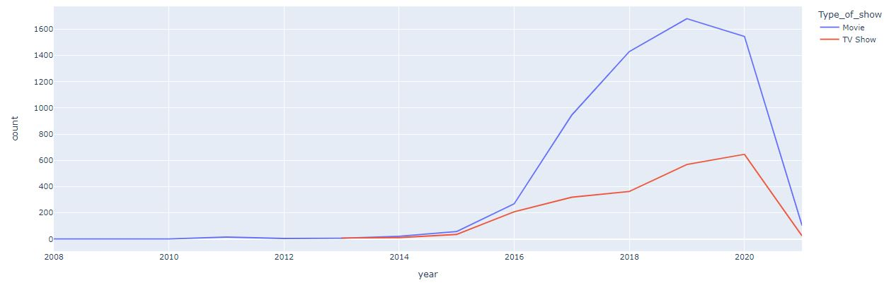
EDA cont.
Analysis of Netflix, whether it is focusing on Movies or TV Shows?
In the plot above, we can see that Netflix has been increasingly focusing on movies rather than TV shows in recent years, as evidenced by the fact that after 2014, Netflix has relied more on movies than TV shows.

Slide 13
Hypothesis testing
In the data_hypothesis variable, we copied the data frame from the data_clean_frame variable.
Then we performed some data augmentation, such as labeling the ratings into grouped categories—
ratings_ages = {
'TV-PG': 'Older Kids', 'TV-MA': 'Adults',
'TV-Y7-FV': 'Older Kids', TV-Y7': 'Older Kids',
'TV-14': 'Teens', 'R': 'Adults',
'TV-Y': 'Kids', 'NR': 'Adults',
'PG-13': 'Teens', 'TV-G': 'Kids',
'PG': 'Older Kids', 'G': 'Kids',
'UR': 'Adults', 'NC-17': 'Adults'’}

Slide 14
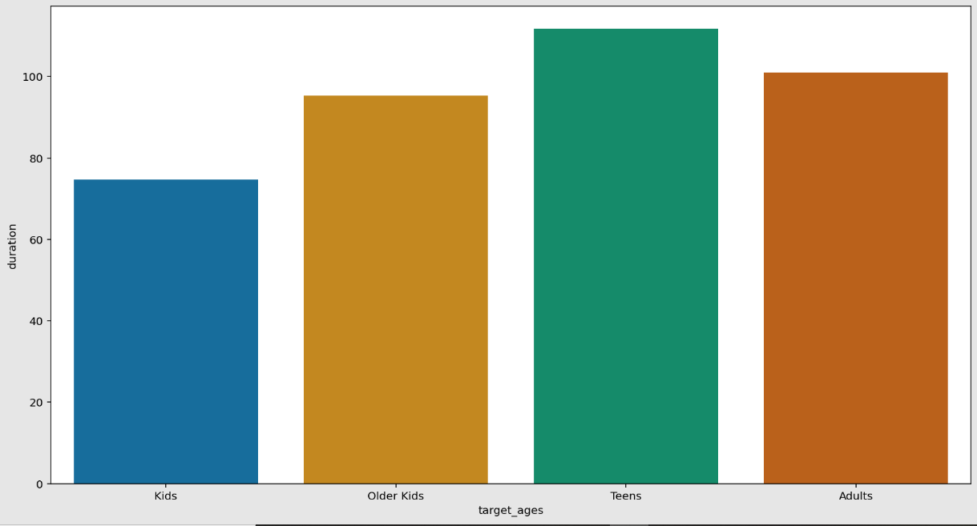
Hypothesis testing cont.
As shown in the graph above, teens have the longest average duration of time for movies, while kids have the lowest.
Then we formed one hypothesis since kids and older kids rated movies are at least 2 hours long.
Then we must reject the null hypothesis since the t-value was not within the range.
As a result, movies rated for kids and older kids are not at least two hours long.

Slide 15
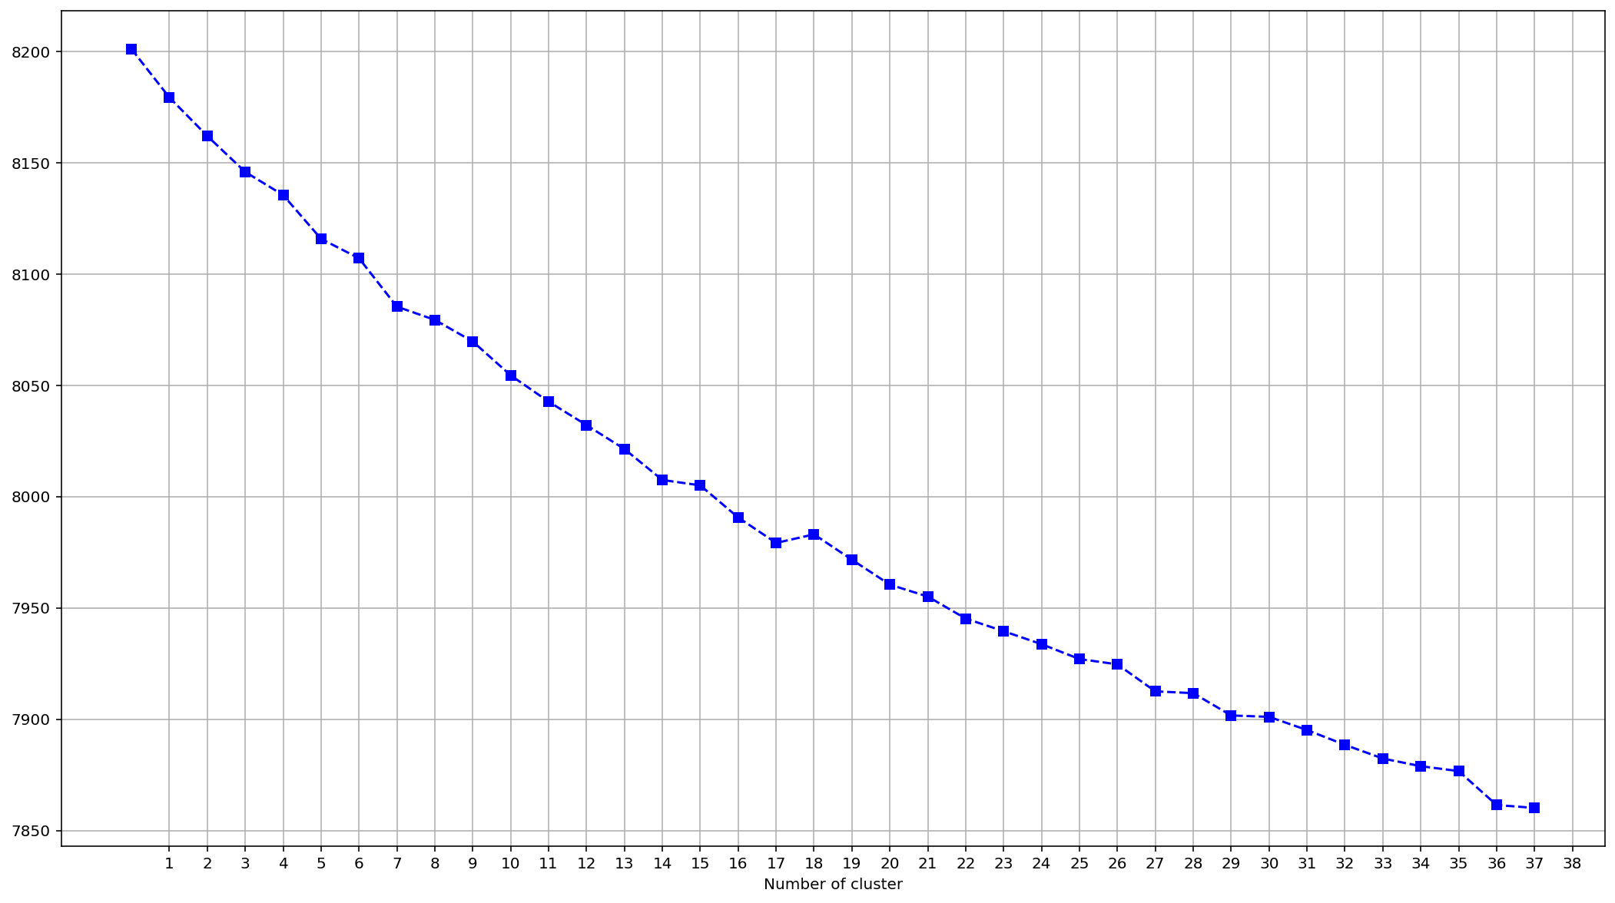
Finding Number of Clusters

Slide 16
Finding Number of Clusters cont.
Clustering is the process of grouping a population or set of data points so that data points in the same group are more similar than data points in other groups. To put it another way, the idea is to distinguish comparable groups and allocate them to clusters.
We used the Elbow method and the Silhouette score to do so, and we chose the 28 clusters based on the results.

Slide 17
Algorithm
Implementation of Kmeans clustering-
After deciding to use 28 clusters, we used the KMEANS clustering algorithm and then we created another column where each row is assigned to its separate clusters.
After assigning clusters, most of the points were assigned to cluster number 9, and the remaining points were not evenly allocated among all clusters.

Slide 18
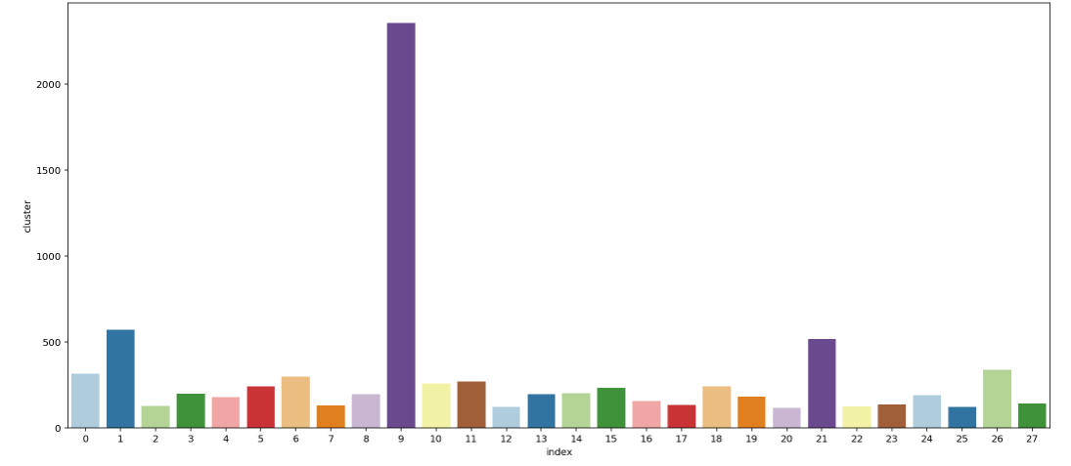
We can observe in the above plot that cluster 9 has the most clusters 2354, while cluster 1 has the second most clusters 569.

Slide 19
Model Performance
Evaluation of our K Means model -
Silhouette’s score was -0.0103
Calinski Harabasz score -10.5299
Davies Boulden Index-9.1133
The Calinski-Harabasz index, also known as the Variance Ratio Criterion, is the ratio of the total of between-cluster dispersion and inter-cluster dispersion for all clusters, divided by the number of clusters. The Davies-Boulden score was computed. The score is defined as the average similarity measure of each cluster to its most comparable cluster, where similarity is defined as the ratio of within-cluster to between-cluster distances.
As a result, we can conclude that our cluster is homogeneous within a cluster and heterogeneous with respect to other clusters.

Slide 20
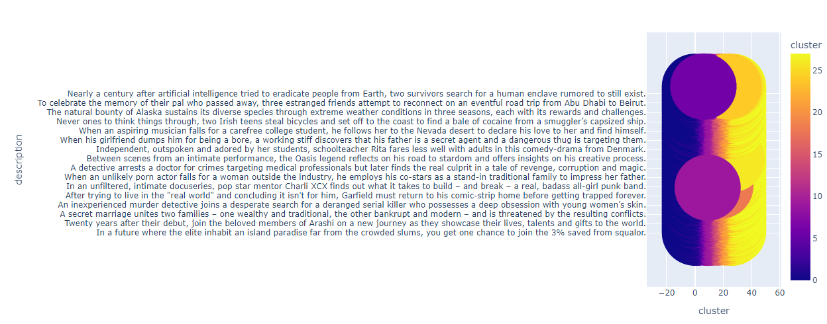
Interactive scatterplot of the cluster

Slide 21
Conclusion
We've done null value treatment, feature engineering, and EDA since loading the dataset, and then we've completed some tasks that were assigned to us.
In this context, we've noticed that Netflix is increasingly focusing on movies rather than TV shows, especially after 2014.
We've also found that different types of content are available in different countries, but TV-MA is the content that is available in the majority of countries. This could be because it shows that it is just for adult audiences, and the Netflix audience enjoys content like this.
We've also defined different clusters based on their content; we've defined 28 clusters and implemented the KMEANS clustering algorithm. And then we determined that cluster number nine has the most clusters; we've also plotted a scatter plot in which we may interact with similar content in connection to that cluster.

Slide 22
Thank you

